Slide 1
MP4: The UNIX Shell
exec*()
fork()
wait()
system()
pipe
Background command
Special command

Slide 2
exec*( ) family
Basic
execl(pathname, …): take a list of args
execv(pathname, argv): take an array of args
E.g.
Custom environment
execle(pathname, …, envp)
execve(pathname, argv, envp)
E.g.
PATH
execlp(filename, …)
execvp(filename, argv)
E.g.
int ret = execl(“/bin/ls”, “ls”, “-l”, (char*)0);
char *env[] = { “HOME=/usr/home”, “LOGNAME=home”, (char*)0 };
int ret = execle(“/bin/ls”, “ls”, “-l”, (char*)0, env);
ü
char *cmd[] = { “ls”, “-l”, (char*)0 };
int ret = execvp(“ls”, cmd);

Slide 3
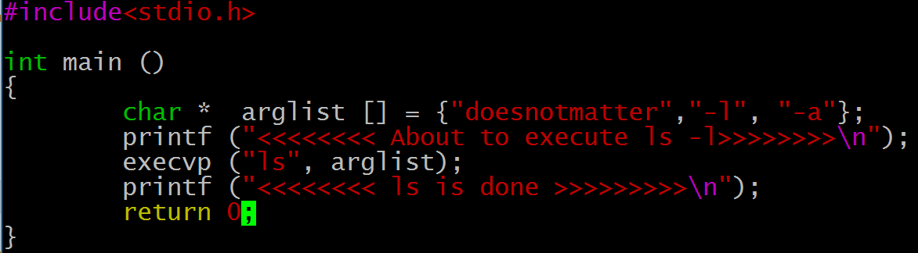
exec*( ) family
exec*() is a brain transplant function
Clears out the machine code of the calling program
Loads the code of the called program
Does not return on success
Can we directly call exec() to handle a user’s command in our shell program?
NO! We’ll lose our shell
So what can we do?

Slide 4
fork( )
Create a new process
Return twice if succeed
0: child process
>0: parent process, the return number is the child’s PID
So we have a new process, then what?
Call exec*() in the child process
Now the user’s command is running, how can we wait until it finishes so that to accept next command?

Slide 5
wait*( )
Synchronize with children
Block current process until one of its children terminates
Return value is the PID of terminated child
parent
wait
shell
fork
shell
child
exec
cmd A
terminate

Slide 6
system ( )
Keep your hands off!
A naïve approach for our shell program is to just use the system() function
Because it takes care of this part for you
parent
wait
shell
fork
shell
child
exec
cmd A
terminate

Slide 7

pipe
An interprocess communication channel
Implemented as FIFO structures through the kernel
Resides in memory
The output of echo becomes the input for wc, data is passed in RAM
What is another naïve approach to such communication, particularly for our shell program?
Use a temporary file
Don’t

Slide 8
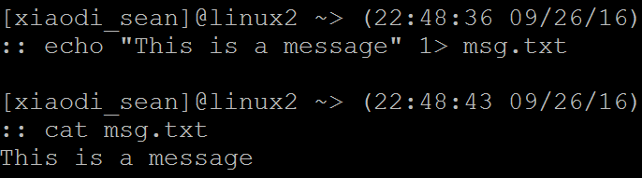
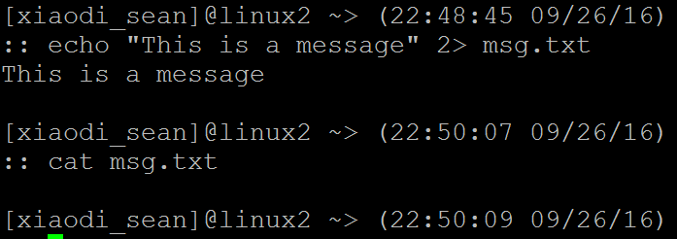
pipe
File descriptor
An abstract indicator used to access a file or other I/O resource (pipe, network socket…)
A non-negative integer
0 (stdin), 1 (stdout), 2(stderr)
Nothing printed
Nothing printed

Slide 9
pipe
Use pipe(fd[2]) to create a pipe
fd[0] refers to the read end of the pipe
fd[1] the write end
Terminal commands use stdin and stdout as I/O by default, we need to “tie” pipes to stdin/stdout
Use dup2(old, new) to make where new points to be the copy of where old points to, thus they refer to the same I/O port

Slide 10
Background command
If the parent process doesn’t wait, the child process will end up as a zombie after finish: Not good!
Instead of using the blocking wait(), use waitpid() with option WNOHANG instead.
Need to periodically poll the status of the child process
Or capture the SIGCHLD signal

Slide 11
Special command
cd
Call chdir() to do the job.
exit
Should we wait for the background process to finish?
You can either wait for it or just kill it.

Slide 12
MP4
Allow users to pipe the standard output from one command to the input of another an arbitrary number of times.
Open a pipe
pipe()
Set stdin and stdout to a pipe
dup2()
Reference
man pipe
man dup2

Slide 13
MP4
Allow users to specify whether the process will run in the background or foreground using an ’&’. Backgrounding processes should not result in the creation of zombie processes.
Cannot use waitpid(pid, NULL, 0), otherwise your shell will not accept new command until the old one finishes.
Two options:
waitpid(pid, NULL, WNOHANG), a non-blocking version, poll is necessary.
Capture the SIGCHLD signal (a parent process will receive this signal whenever its child process exits)

Slide 14
MP4
Allow your program to take an option ”-t” which will run your shell the same way, just without a prompt.
No prompt.
(Bonus) Allow users to specify a custom prompt which supports printing the current directory, username, current date, and current time.
A customized prompt.
E.g. user:/home/user/svn$

